Slide 1

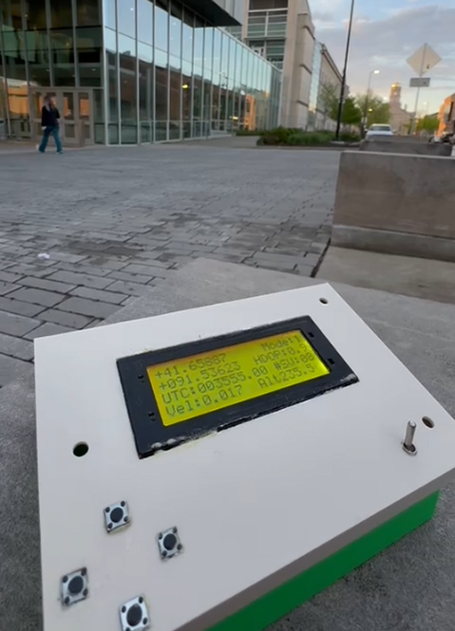
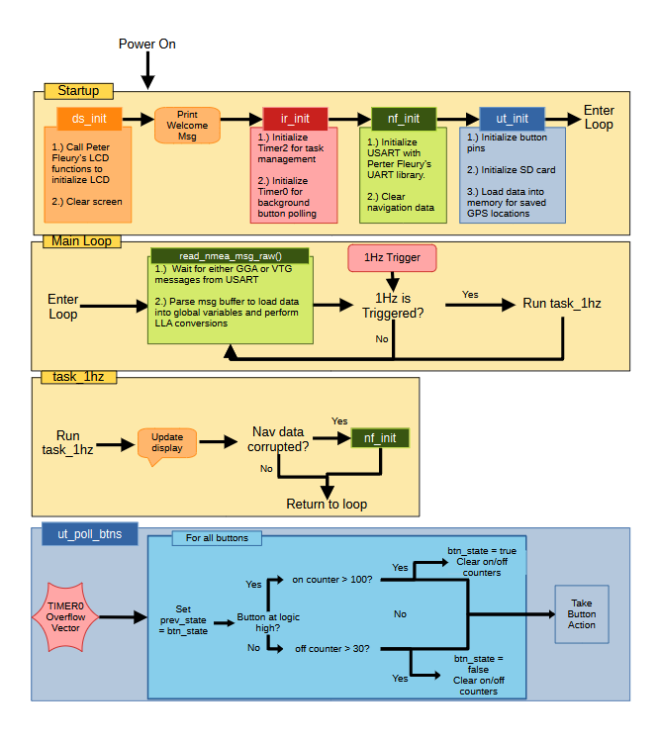
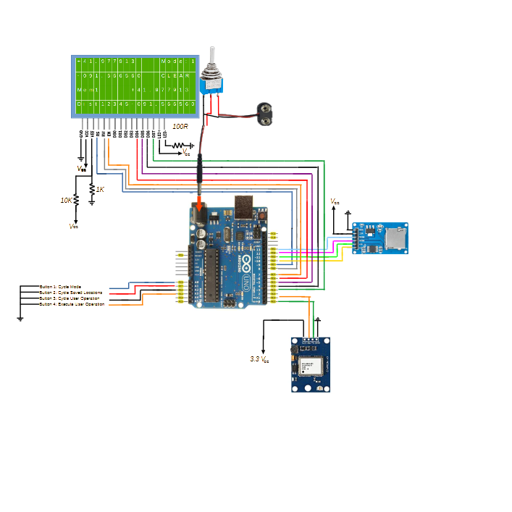
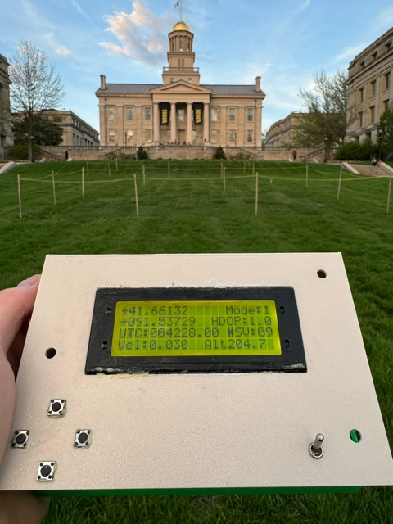
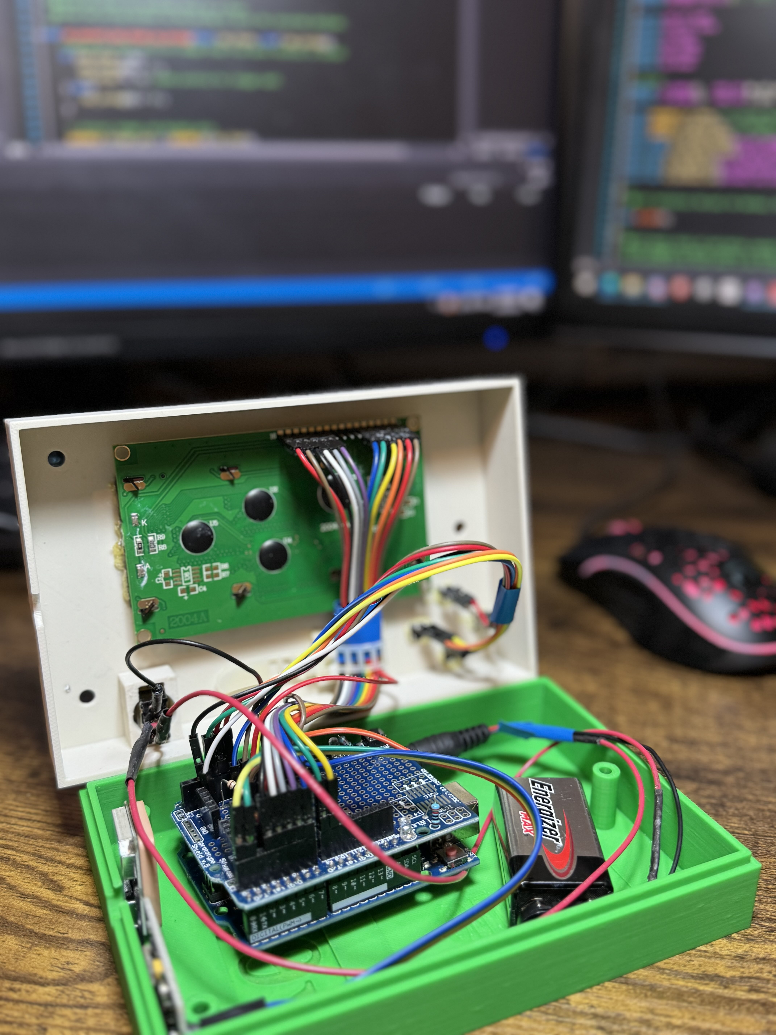
WayFindX – Handheld GPS Navigation Device
Team Members: Bradley Johnson, Abele Atresso
Abstract
WayFindX is a handheld GPS receiver project developed by Bradley Johnson and Abele Atresso. The project aims to create a portable navigation device that enhances outdoor navigation capabilities for users such as hikers, adventurers, and outdoor enthusiasts. WayFindX provides essential features including position and velocity tracking, storage of multiple locations, and distance calculation to selected stored positions.
Introduction
The WayFindX was inspired by the group’s desire to create a useful product with practical applications. It allows for easy distance estimation out in open areas or over long distances where other measuring tools are not feasible. It also could be used to lay a “trail of breadcrumbs.” The user has 10 way points which they can leave behind to find their way back.
The WayFindX also allows users to answer the age-old question: “I wonder how far it is from here to ___?” Additionally, the STAT mode gives users the capability to nerd out about the GPS GNSS Constellation; letting them monitor their HDOP, the number of Svs used in their PVT solution, their ground speed, their altitude, and UTC time in seconds.
Caption: Picture of WayFindX running in STAT Mode (Mode 0)
System Description
Key Features:
Display of user position and velocity information
Storage of multiple locations for navigation
Calculation of distance to selected stored positions
Intuitive user interface with control buttons and LCD display
Reduced clock-speed of 4MHz increases battery life
The project utilizes the following hardware components:
Arduino microcontroller (ATMega328p)
HD44780 Controlled 20x4 LCD for display
Four buttons for user input
NEO-6M GPS module for positioning
Power Switch and 9V battery for power management
SD Card and SD Card Adapter Module for non-volatile storage
Caption: Software Flow Overview
Caption: Hardware Schematic Overview.
Results
Development began with a detailed preliminary design; making sure that the project would be feasible within the time frame and minimizing problems before they become an issue. Then we developed on a prototype breadboard for rapid software development while the box was being 3D printed. During hardware assembly care was taken to ensure a clean and well-managed inside as users would need to access it in order to change the battery and it makes it easier to trouble shoot when wires/soldering are carefully and thoughtfully managed.
The WayFindX proves to be a useful and fun-to-use handheld GPS device. In testing, the WayFindX has a position error that matches that of an iPhone and an error in its distance calculation of only about 2 meters in small distances. (This is due to floating point errors introduced by the limitations of the 16-bit ATMega328P).
Caption: WayFindX at the base of the Old Capitol; showing distance to Seamans Center
Caption: Exposed WayFindX device.
Lessons Learned
Conclusion
UART can be thrown off by shaking and electric noise; this can be fixed in software by detecting it and re-initializing UART.
DONT TRY TO GLUE 4 BUTTONS AT ONCE WITH ONLY TWO HANDS! Instead, glue them one at a time.
Doing string to floating point conversions manually can be thwarted by floating point arithmetic errors. Just use standard libraries for that.
When designing a 3D print, ensure meticulous consideration for every component, leaving ample space for wires and ensuring all elements fit snugly within the same enclosure for seamless integration and optimal functionality.
The WayFindX proved to be a successful prototype device that in its current state would be a fun device to have on hikes, camping trips, or exploring. We already have ideas for how to improve it: rechargeable battery, seamless switching between wall-powered/battery powered, adjustable contrast, LED on/off switch for day time power conservation.
References (If Needed)
Special thank you to:
Peter Fluery for the use of his LCD and UART libraries
RJH from University of Texas at Dallas for his guide on interfacing with an SD card via SPI
ECE:3360 Embedded Systems 2024
The University of Iowa

